Slide 1
ARTIFICIALLY INTELLIGENT LOGISTIC MANAGEMENT SYSTEM
BY GROUP 4
PROFESSOR: MARCOS B
DEVENDRANATH SANTHOSH
DHRUVA LOYA
NICHOLAS WILLAM
PRASAD BABU VENUGOPAL

Slide 2
PHASE 1
IDENTIFY PROBLEM AND DECIDE ON SOLUTION
TRADITIONAL GROCERY STORES MAKE PEOPLE TO STAND IN LINES TO ADD THE ITEMS IN THE CART DURING THE CHECKOUT AND THIS IS A BIG PROBLEM FOR PEOPLE IN BIG GROCERY STORES STANDING IN LINES FOR LONGER TIMES
SO WE CAME UP WITH A SOLUTION WHICH IS CREATING AN APP WHICH IS USED TO SCAN THE OBJECTS IN A GROCERY STORE TO UPDATE THE CART AND INVENTORY SIMULTANEOUSLY FOR EASY CHECKOUTS.

Slide 3
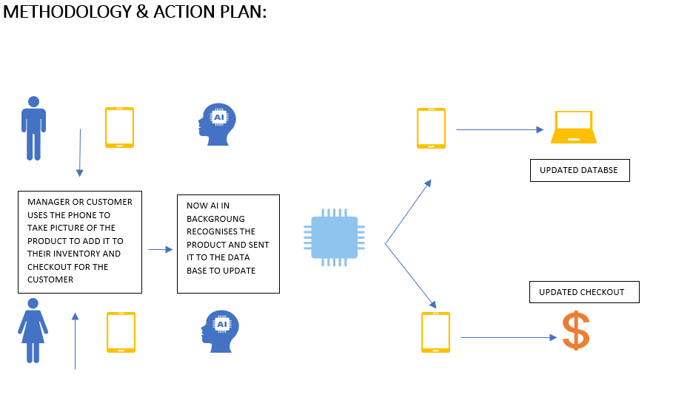
PHASE 2
CREATED A BLUEPRINT
HOW TO DEVELOP AND EXECUTE THIS PROJECT

Slide 4
PHASE 3
DATA PREPARATION AND ALGORITHM SELECTION
MODEL STRUCTURE
SOFTWARE TOOLS
CALIBRATION AND MODEL TECHNIQUES
MODEL ARCHITECTURE AND SOFTWARE PIPELINE
DATA ASSUMPTIONS, LIMITATIONS, CONSTRAINTS

Slide 5
PHASE 4
CURRENT STATE
MACHINE LEARNING ALGORITHM
IMAGE RECOGNIZING MOBILE APP
INVENTORY MANAGEMENT SOFTWARE
Notes:
IN THE PHASE 4 WE COLLECTED THE DATA FROM VARIOUS SOURCES AND CREATED A DATASET FOR OUR ALGORITHM. WE THEN STARTED TO CREATE THE MACHINE LEARNING MODEL USING THE DATASET. WE TRAINED AND TESTED THE DEVELOPED MACHINE LEARNING ALGORITHM AND IT WAS A SUCCESS.
NEXT, WE CREATED A DATA BASE WITH THE DATASET THAT WE USED IN THE MACHINE LEARNING MODEL WHICH IS APP BASED USING SQL LITE
FINALLY WE HAVE CREATED A MOBILE APP(ANDROID) FOR REAL TIME OBJECT DETECTION USING THE TENSORFLOW LITE.

Slide 6
PHASE 5
NEXT STEPS
INTEGRATION OF MOBILE APP AND INVENTORY MANAGEMENT SOFTWARE
FINAL REPORT PREPARATION
MAJOR CHALLENGE
NO EXPERTISE IN TEAM FOR INTEGRATION ACTIVITY
Notes:
WE ARE CURRENTLY IN THE PHASE 5 WHERE WE ARE TRYING TO INTEGRATE THE THREE MAIN COMPONENTS OF OUR PROJECT WHICH IS THE MACHINE LEARNING ALGORITHM, DATABASE AND MOBILE APPLICATION
WE ARE TRYING VARIOUS INTEGRATED DEVELOPMENT ENVIRONMENTS(IDE) TO INTEGRATE THE THREE COMPONENTS

Slide 7
THANK YOU

